Slide 1
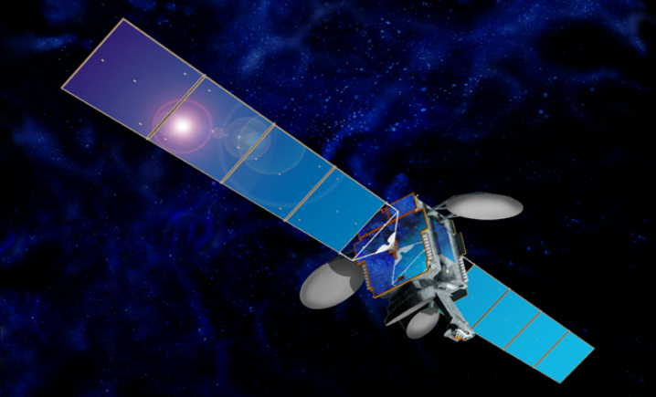
Commercial Broadband Satellites & The U.S. Regulatory Framework
Internet Society’s Indigenous Connectivity Summit 2020 Training Session, September 29, 2020
Jim Schlichting
Senior Deputy Chief
International Bureau
Federal Communications Commission

Slide 2
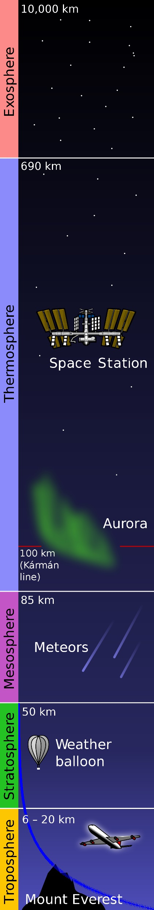
What is a Satellite?
A “space station” is a “station located on an object which is beyond, is intended to go beyond, or has been beyond, the major portion of the Earth's atmosphere. (RR)” 47 CFR Section 25.103.
Karman Line = 80-100 kilometers altitude
International Space Station = approx. 410 km
Moon = approx. 360,000 - 400,000 km (elliptical orbit)

Slide 3
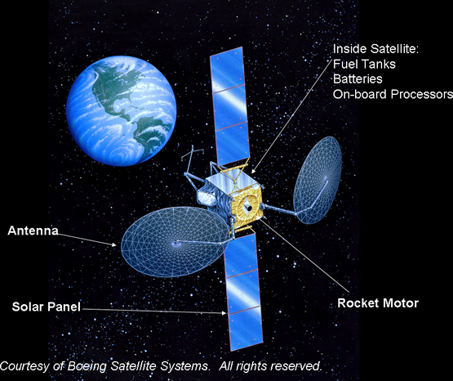
Traditional Satellites
Basic Satellite Anatomy

Slide 4
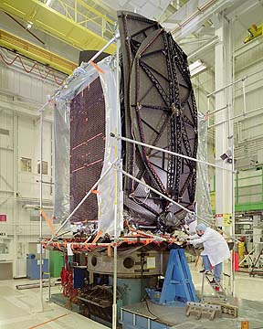

Diversity of Satellites
Planet Labs “Dove” Satellite
10cm x 10cm x 70 cm, deployed
4 kg
5-8 year lifetime
Low-Earth Orbit
Boeing 702 Satellite
50 meters long, deployed
4700 kg, fueled
15 year+ lifetime
Geostationary Orbit

Slide 5

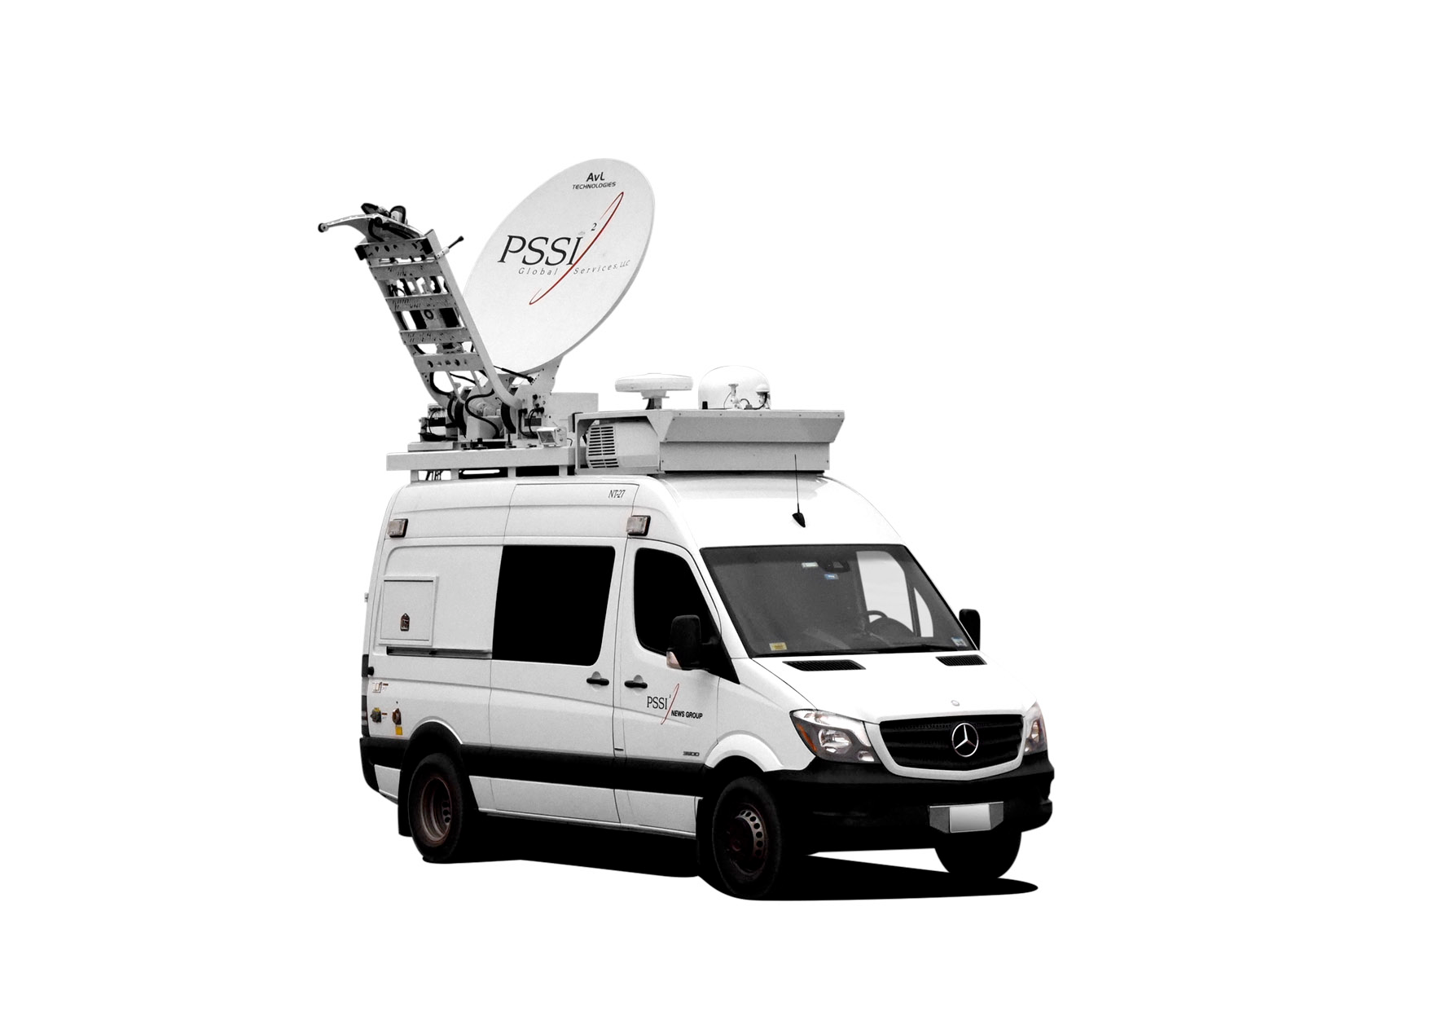


Satellite Networks
Earth Station Types
UPLINK: signal from
earth station to space
Station
DOWNLINK: signal
from space station to
earth station
Earth Station(s):
User Terminals
Earth Station(s):
Gateway, Feeder Link

Slide 6
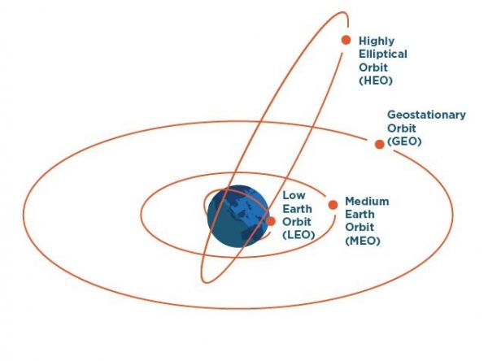
Satellite Orbits
Commonly Used Orbits
Geostationary Orbit (GSO)
Non-Geostationary Orbit (NGSO)
Low-Earth Orbit (LEO)
Medium-Earth Orbit (MEO)
Highly-Elliptical Orbit (HEO)

Slide 7

GSO Satellites
Geostationary orbit (GSO)
Examples: ViaSat, Hughes
Equatorial plane
35,786 km high (about 22,000 miles)
Period of orbit = Period of earth’s rotation
Appears fixed in sky

Slide 8
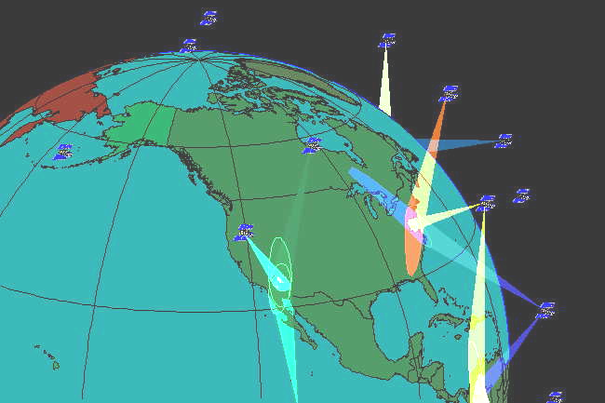
LEO Satellites
Low-earth orbits (LEO)
Examples: SpaceX, OneWeb
Altitudes up to 2000 km
Orbital periods faster than earth’s rotation

Slide 9
Satellite Broadband GSO Systems for the U.S.
2 major GSO broadband providers in the United States: Viasat and Hughes
Viasat
~600,000 U.S. fixed residential/small business subscribers
Universal service funding: awarded $87.1M over 10 years to serve 121,700 remote and rural homes and businesses in 17 states at 25/3 Mbps or above
Satellites: Viasat-1 (140 Gbps), Viasat-2 (300 Gbps) in orbit; Viasat-3 (1 Terabit) reportedly scheduled for launch in 2nd half/2021
Coverage: contiguous U.S. and southern Alaska
Hughes
~1.2M U.S. fixed residential/business subscribers
Universal service funding: awarded ~$30M in state, federal, and private grants over 10 years to serve 78,960 remote and rural homes and businesses in New York state at 25/3 Mbps or above
Satellites: Jupiter 1 (100 Gbps) and 2 (200 Gbps) in orbit; Jupiter 3 (500 Gbps) reportedly scheduled for launch in 2nd half/2021
Coverage: contiguous U.S. and southern Alaska

Slide 10
Satellite Broadband NGSO Constellations for the U.S.
NGSO Constellations Operating in the Fixed-Satellite Service or FSS
Significant industry Interest in developing and deploying large constellations of small NGSO satellites with robust capabilities to be used for global Internet connectivity
Usually large constellations of smaller satellites; need many LEO satellites in a constellation to provide global continuous coverage
Commission has licensed twelve companies starting in 2017 with proposals ranging from 2 satellites to more than 4,000 satellites
Seven of the companies plan to focus on broadband to end-user
Licensed in the Ku-, Ka-, and V- spectrum bands
Commission has emphasized in licensing decisions the role NGSO satellite constellations can play in providing broadband particularly in rural and remote areas.
Launch, deployment, and testing of the first operational satellites has already begun.

Slide 11
Satellite Broadband NGSO Constellations for the U.S.
Highlighting Two Proposed Systems
SpaceX Starlink System
Licensed in March 2018 (Ka/Ku bands) and Nov 2018 (V-band) and approved two modification applications to date
Constellation of 4,409 in Ka/Ku/V bands; additional 7,518 satellites in V-band
Building and launching its own satellites; launching ~ 60 at a time
Has launched over 700 satellites to date
SpaceX reports recent beta tests speeds at over 100 mbps using standard user equipment and latency far below 40-50 milliseconds round trip to the internet
WorldVu Satellite Limited (OneWeb)
FCC granted access to the U.S. market in 2017 (Ka/Ku bands) and Aug 2020 (V-band) (UK licensed system)
Approved constellation of 720 satellites in Ka/Ku bands operating at an altitude of 1,200 km and an additional 1,280 V-band satellites at 8,500 km
Assembly line model for production of satellites
Has launched over 74 satellites
Emerging from bankruptcy

Slide 12
Satellite Broadband - NGSO
System (Date Granted) | Number of Satellites Orbit Altitude | Licensing Administration
OneWeb (June 2017 Ku/Ka band) (Aug. 2020- V-band)) | 720 satellites - Ku/Ka/V-bands 1,200 km 1,280 satellites - V-band 8,500 km | UK
TeleSat Canada (Nov. 2017 – Ka-band) (Nov. 2018 – V-band) | 117 satellites - 1,000-1,248 km | Canada
Space Norway (Nov. 2017 – Ka-band) | 2 satellites - Apogee 43,509 (km) to perigee 8,089 km | Norway
SpaceX (March 2018 – Ku/Ka bands with modifications granted in April 2019 and Dec. 2019) (Nov. 2018 – V-band) | 4,409 satellites - Ku/Ka/V bands * 1,584 operate at 550km * Remaining operate at 1,150 km Additional 7,518 satellites V-band - altitudes from 335 km to 346 km | US (with Norway filings)
O3b/SES (June 2018 – Ka, Ku, V-band) | 42 satellites - 8,062 km (16 out of 42 have V-band) | UK
ViaSat (April 2020 – Ka and V-bands) | 20 satellites - Proposed MEO satellites will operate at 8,200 km. | Netherlands
Kuiper (Amazon) (July 2020 – Ka-band as part of the “second processing round”) | 3,236 satellites in 98 orbital planes 590 km, 610 km, and 630 km | US

Slide 13
Licensing Basics - Satellites
Facility-based licensing
License is for a station in a specific orbit using specific frequencies
ORBIT Act states that the FCC shall not have the authority to assign by competitive bidding orbital locations or spectrum used for the provision of international or global satellite communications services. 47 U.S.C. Section 765f
License term for non-broadcast space stations is 15 years
Milestones to launch and operate; escalating bond requirements
Technical Requirements – e.g., Spacing, Prevention Of Interference, Mitigation Of Orbital Debris
All space station licenses are subject to the outcome of international ITU coordination
Requests by non-U.S.-licensed satellites to access the U.S. market treated the same as applications for FCC licenses; market access is NOT a license, but the review process is largely the same and grantees must meet same technical and legal requirements as U.S-licensees

Slide 14
Licensing Basics - GSOs
“GSO-like”: First-Come, First-Served Framework. 47 CFR Section 25.158
Applications for GSO-like satellite operations placed in a queue and considered in the order that they are filed
Application reviewed to determine whether it is acceptable for filing; if acceptable for filing, will be placed on public notice
Application will be granted if:
the Commission finds that the applicant and its proposed facilities and operations comply with all applicable regulations and policies, and that grant of the application will serve the public interest, convenience and necessity
The proposed satellite will not cause harmful interference to any previously licensed operations
A license applicant for GSO-like satellite operation must not transfer, assign, or otherwise permit any other entity to assume its place in any queue

Slide 15
Licensing Basics – NGSO FSS
“NGSO-like”: Modified Processing Round. 47 CFR Section 25.157
The first application to be filed is a “lead” application that initiates a processing round, and establishes a cut-off date for competing applications
Other application filed during the processing round are “competing” applications
After review, Commission will grant all applications that meet standards for grant and deny the other applications
Operators are required to coordinate systems to avoid interference between systems
If coordination is unsuccessful, operators are required to split the spectrum in circumstances where a specified interference threshold is exceeded
Milestones
Deploy 50% of the total number of authorized satellites in 6 years; remaining in 9 years
Failure to meet the milestone, authorization will be reduced to the number of satellites in use on the milestone date; bond is forfeited

Slide 16
Licensing Basics - Earth Stations
Transmitting earth stations must be licensed
No license required for receive-only earth stations operating with U.S. Satellites and approved foreign satellites
Optional registration for receive-only antennas
Earth stations meeting specified technical criteria are routinely processed

Slide 17
Commercial Broadband Satellites & The U.S. Regulatory Framework
Internet Society’s Indigenous Connectivity Summit 2020 Training Session, September 29, 2020
Jim Schlichting
Senior Deputy Chief
International Bureau
Federal Communications Commission

