Slide 1
How IXPs are supporting the Internet during COVID-19
Kenneth Chan
HKIX
25 Jun 2020

Slide 2
Coronavirus Disease (COVID-19) in Hong Kong
Total Cases: 1,178 Confirmed / 89 Hospitalized / 1 Critical / 6 Death (as of 23 Jun 2020)
All schools closed from Feb 3 to May 26 after Lunar New Year holidays
Feb 3 The Education Bureau announced all schools closed. Universities and colleges were started moving to online teaching
Schools gradually resumed from May 27 and onwards
Schools Closed
Government announced its office closed from Jan 29
Government announced office closed again on Mar 22
Mar 25 Hong Kong closed its border to all incoming non-residents
Government announced office resumed on May 5
Government office started to resume on Mar 2
WFH
WFH
Jan 25 HK government declared the viral outbreak as an "emergency"
Mar 29 Indoor and outdoor gatherings were limited to 4 persons
Jun 19 The cap for gathering was relaxing to 50 for outdoor and unlimited for indoor
Jan 29 All government employees were instructed to work from home. Some organization and companies followed the arrangement.
Apr 1 Karaoke lounges, nightclubs and mah-jong premises closed
First case confirmed on Jan 23
Apr 3 Pubs and bars were ordered to close for 14 days
Feb 4 Reported first death in HK
May 5 Some of above premises were reopening and the cap for gathering has increased to 8 persons
No. of new confirmed cases (Jan 23 - Jun 21)
Notes:
https://en.wikipedia.org/wiki/COVID-19_pandemic_in_Hong_Kong

Slide 3
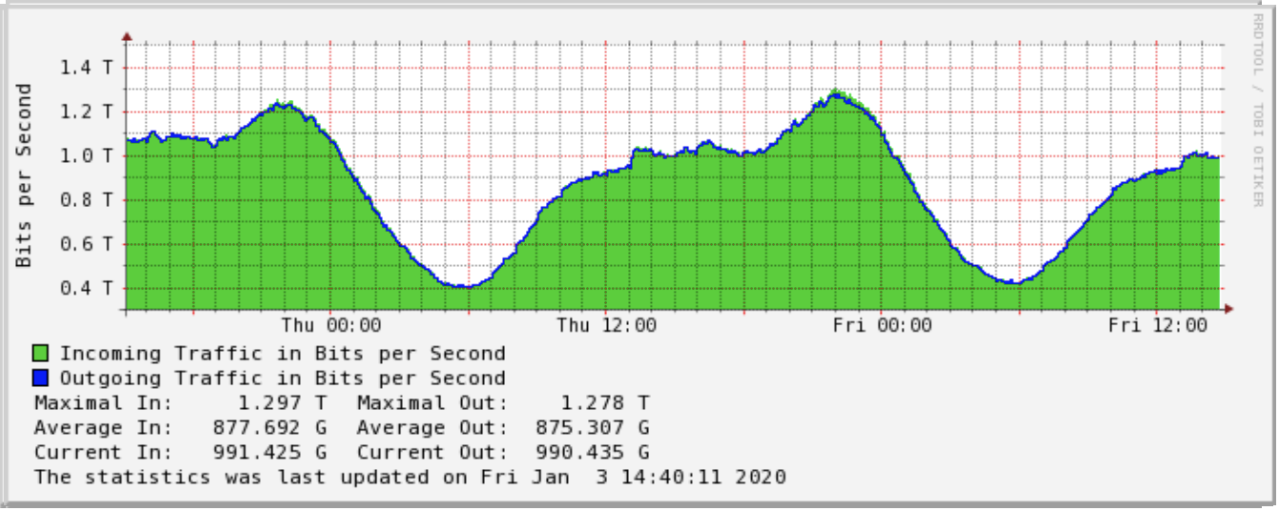
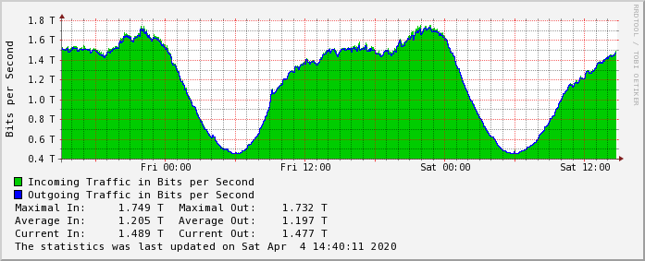
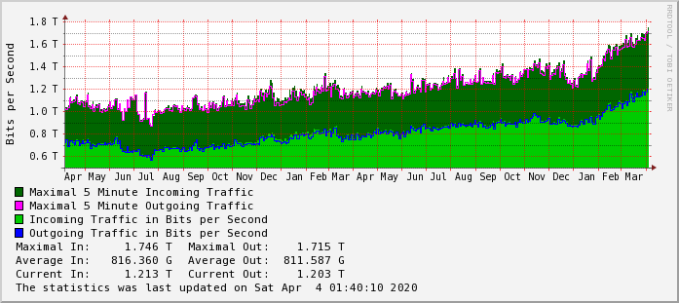
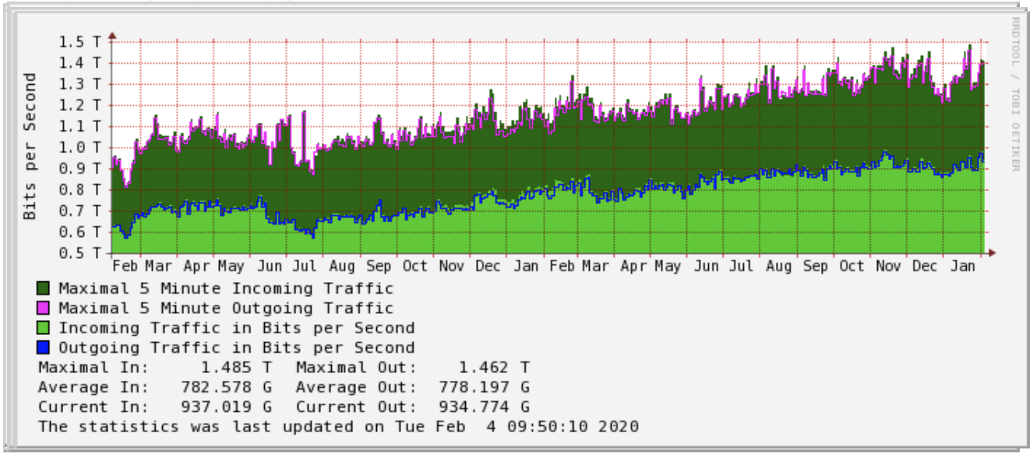
HKIX Traffic – Before and after work from home
Daily Graph (5-minute Average)
Daily Graph (5-minute Average)
Traffic patterns are similar (e.g. peak and non-peak time)
Traffic was increased faster in the morning between 0600 and 1200 (83Gbps/hr→158Gbps/hr)
The duration of peak time was longer (2hrs→3hrs)
Peak duration
Peak duration
500Gbps
950Gbps
0600-0900
0600-0900
Before WFH: 3 Jan 2020
After WFH: 4 Apr 2020
Yearly Graph (1-day Average)
Jan 23
Yearly Graph (1-day Average)
˜35% increases on peak traffic
~30% increases on daily average

Slide 4
Some observations on traffic and port demands during COVID-19
People are forced or recommended WFH during the COVID-19 outbreak
Number of ports increased (29% on 100GE and 3% on 1/10GE)
HKIX traffic increased ˜35%, from 1.3Tbps to ~1.75Tbps from late Jan to mid Apr
The increased traffic was mainly from various online platforms
Video conferencing / collaboration tools
Online teaching / e-learning
Video streaming
Online gaming
Internet banking
Online shopping
Most of these providers had 30-40% traffic increment while video conferencing, Internet banking and online shopping had a record of 200%-300% significant growth

Slide 5
Impacts on IXP operations at HKIX
All sales orders are being handled and processed by emails
Technical support and provision team could work from home to provide the services
Pre-installed cabling infrastructure and switch ports at HKIX to speed up the provision of service
Local loop providers to install the circuits and perform onsite testing
Remote NOC to provide 24/7 non-stop operational services
Network maintenance and project works were postponed

Slide 6
Additional services and support for customers
Precaution measures against COVID-19 in Data Centre
NOC to provide 24/7 network monitoring and support services
Monitor traffic usage on inter-switch links and participant links
Reminder emails were sent to participants when the links are full
Additional switches and inter-switch links deployment
Additional switches are installed in core and satellite site
Inter-switch links and inter-site links are added
Allow customer suspend the service (max. 3 months) temporarily to reduce the cost upon request

Slide 7
Thank You! For enquiries, please contact us at info@hkix.net

