Slide 1
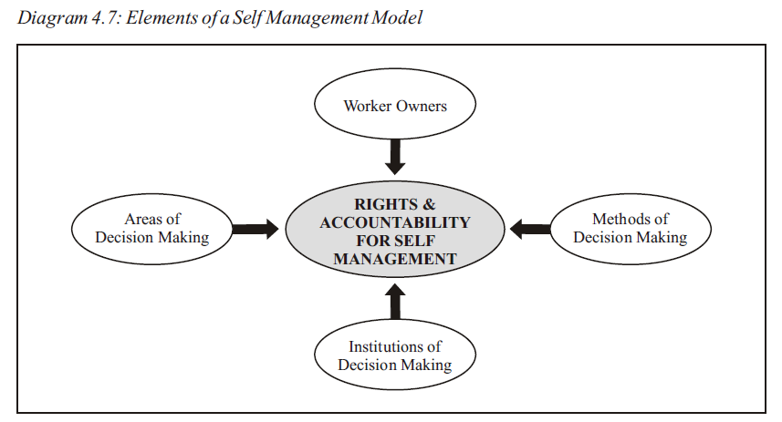
Source: Building a solidarity economy, A guide for grassroots activism, Cooperative and policy alternative centre (COPAC)

Slide 2
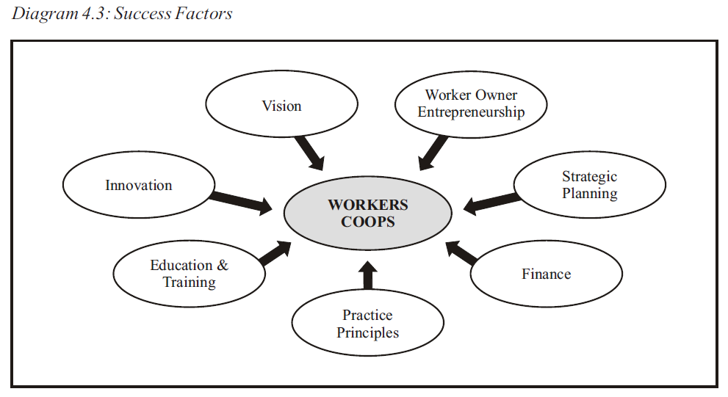
Source: Building a solidarity economy, A guide for grassroots activism, Cooperative and policy alternative centre (COPAC)

Slide 3
Cooperative and policy alternative centre (COPAC) https://copac.org.za/

