Slide 1
IoT and the Online Trust Alliance framework
African Union Commission
April 2019
Robin Wilton
Senior Adviser, Internet Trust
wilton@isoc.org
Presentation title – Client name

Slide 2
The Internet Society
Vision: an Internet that is open, globally connected, trustworthy and secure
Mission: to ensure that the benefits of the Internet reach everyone
Key themes: build, promote and defend trust on the Internet

Slide 3
Three Topics
Privacy, security and social impacts of IoT
The Internet Society’s OTA Trust Framework
The Internet Society’s trust-mark work with Consumers International
Notes:
Data protection principles such as the OECD’s date back to 1981, and numerous national and cross-border schemes have been developed since then:
The APEC Cross-Border Privacy Rules, the Council of Europe’s Convention 108, the ECOWAS and HIPSSA initiatives in Africa, US-EU Safe Harbour and Privacy Shield, EU Data Protection Directive and GDPR, and so on.
So why are outcomes not better, for consumers?
- We see flashlight apps that harvest users’ contact book data; smart TVs that record people’s conversations;
- An adtech industry that collects and mines consumers’ data, almost entirely invisible to the consumer, and over which the consumer has no control: (https://adcontrarian.blogspot.co.uk/2017/02/adtechs-massive-failure.html)
- “Consent” notices that give users no effective choice – for instance, the cookie consent notices called for under EU law;
Collection of intimate behavioural and location data, again with little or no user consent and control.
We also see data breaches from public sector and commercial entities alike, sometimes with the goal of exploiting the data itself, sometimes to hold the data to ransom (the next slide gives the Cloudpets ”connected toy” example).
Regulatory compliance requirements do not seem to be producing the desired behaviour, on the part of data controllers and service providers.

Slide 4
More distributed devices, more centralisation of data
Machine-to-machine connectivity intensifies data collection and aggregation
The bulk of this data will be about users
Such a surge in the volume of centralised data is bound to have a profound impact on individual privacy
We’re often told we live in the Information Society: we’re less often reminded that most of the information is in the hands of others.
5

Slide 5
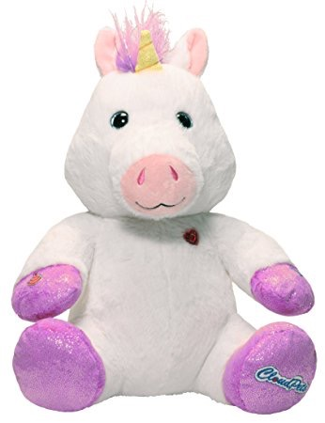
Consumers and Contexts
Would you pay a stranger to walk into your child’s bedroom?
Pay for the toy,
Pay again with your data,
Pay again when the data is ransomed!
No need to worry about security, simply enable Bluetooth on your phone!
One retail product, aimed at young children
Over 800,000 accounts/profile photos compromised
Over 2 million voice recordings exposed
Notes:
Here is a recent and, in many ways, shocking example.
Just one retail product resulted in the exposure of over 800,000 user accounts, and over 2 million voice recordings exchanged between children and their parents and grandparents.
Cloudpets “smart” cuddly toys are designed so that children can send and receive spoken messages, via the toy, the accompanying app, and the “cloud”.
However, security researchers found that the company’s databases of user details and (separately) voice recordings were not secure.
https://threatpost.com/cloudpets-notifies-california-ag-of-data-breach/124002/
The researchers also report that hackers copied and deleted the databases, so as to hold customers to ransom for the release of their records.
The toys used Bluetooth to communicate locally, and were accessible to any Bluetooth-capable handset within range.
The researchers also demonstrated a way to turn the toy into a remote recording device.
Technology has allowed the creation of a series of business models that result in users assuming they are getting one deal (buying a toy),
while in fact they are signing up to a number of other transactions as well, some of which are hostile to their interests.
The economics of data monetization are so powerful that consumers have little chance of influencing market behaviour for the better.

Slide 6
Lessons from the connected toy
Security of the device was not designed in
Security of the back end was not designed in
What value set does this approach indicate?
Insecurity has a cost – but who does the cost fall on?
Security and privacy reflect values that must be designed in from the outset
Value-based design is a maturing discipline
Notes:
Here is a recent and, in many ways, shocking example.
Just one retail product resulted in the exposure of over 800,000 user accounts, and over 2 million voice recordings exchanged between children and their parents and grandparents.
Cloudpets “smart” cuddly toys are designed so that children can send and receive spoken messages, via the toy, the accompanying app, and the “cloud”.
However, security researchers found that the company’s databases of user details and (separately) voice recordings were not secure.
https://threatpost.com/cloudpets-notifies-california-ag-of-data-breach/124002/
The researchers also report that hackers copied and deleted the databases, so as to hold customers to ransom for the release of their records.
The toys used Bluetooth to communicate locally, and were accessible to any Bluetooth-capable handset within range.
The researchers also demonstrated a way to turn the toy into a remote recording device.
Technology has allowed the creation of a series of business models that result in users assuming they are getting one deal (buying a toy),
while in fact they are signing up to a number of other transactions as well, some of which are hostile to their interests.
The economics of data monetization are so powerful that consumers have little chance of influencing market behaviour for the better.

Slide 7
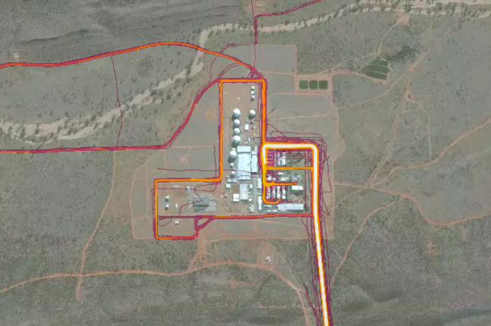
Governments and Contexts
In the Good Old Days, a stuffed unicorn was just a stuffed unicorn.
Nowadays, a fitness tracker might personally identify military/intelligence staff.
Governments need to be aware of the erosion of “privacy contexts”, often without the individual’s awareness, consent or control.
Notes:
Here is a recent and, in many ways, shocking example.
Just one retail product resulted in the exposure of over 800,000 user accounts, and over 2 million voice recordings exchanged between children and their parents and grandparents.
Cloudpets “smart” cuddly toys are designed so that children can send and receive spoken messages, via the toy, the accompanying app, and the “cloud”.
However, security researchers found that the company’s databases of user details and (separately) voice recordings were not secure.
https://threatpost.com/cloudpets-notifies-california-ag-of-data-breach/124002/
The researchers also report that hackers copied and deleted the databases, so as to hold customers to ransom for the release of their records.
The toys used Bluetooth to communicate locally, and were accessible to any Bluetooth-capable handset within range.
The researchers also demonstrated a way to turn the toy into a remote recording device.
Technology has allowed the creation of a series of business models that result in users assuming they are getting one deal (buying a toy),
while in fact they are signing up to a number of other transactions as well, some of which are hostile to their interests.
The economics of data monetization are so powerful that consumers have little chance of influencing market behaviour for the better.

Slide 8
What about sensors… does simpler mean better?
One sensor gives you a data point (or maybe several): a CO room sensor might also measure CO2
CO2 measurements might allow inferences about human occupancy of the room; CO2 production data might allow inferences about activity levels in the room.
All of a sudden, simple sensor data isn’t so binary any more.
(Thanks to Ted Hardie, Chair of the Internet Architecture Board for the example)
”Smart” devices aren’t usually smart – they’re usually dumb – but still connected.
That means the intelligence is elsewhere. Who controls it?
Notes:
Here is a recent and, in many ways, shocking example.
Just one retail product resulted in the exposure of over 800,000 user accounts, and over 2 million voice recordings exchanged between children and their parents and grandparents.
Cloudpets “smart” cuddly toys are designed so that children can send and receive spoken messages, via the toy, the accompanying app, and the “cloud”.
However, security researchers found that the company’s databases of user details and (separately) voice recordings were not secure.
https://threatpost.com/cloudpets-notifies-california-ag-of-data-breach/124002/
The researchers also report that hackers copied and deleted the databases, so as to hold customers to ransom for the release of their records.
The toys used Bluetooth to communicate locally, and were accessible to any Bluetooth-capable handset within range.
The researchers also demonstrated a way to turn the toy into a remote recording device.
Technology has allowed the creation of a series of business models that result in users assuming they are getting one deal (buying a toy),
while in fact they are signing up to a number of other transactions as well, some of which are hostile to their interests.
The economics of data monetization are so powerful that consumers have little chance of influencing market behaviour for the better.

Slide 9
It’s not so much the data, as what can be done with it
Inference and correlation change the picture dramatically
The same data may mean very different things to different people
Not all stakeholders are focused on the common good (!)
Notes:
Here is a recent and, in many ways, shocking example.
Just one retail product resulted in the exposure of over 800,000 user accounts, and over 2 million voice recordings exchanged between children and their parents and grandparents.
Cloudpets “smart” cuddly toys are designed so that children can send and receive spoken messages, via the toy, the accompanying app, and the “cloud”.
However, security researchers found that the company’s databases of user details and (separately) voice recordings were not secure.
https://threatpost.com/cloudpets-notifies-california-ag-of-data-breach/124002/
The researchers also report that hackers copied and deleted the databases, so as to hold customers to ransom for the release of their records.
The toys used Bluetooth to communicate locally, and were accessible to any Bluetooth-capable handset within range.
The researchers also demonstrated a way to turn the toy into a remote recording device.
Technology has allowed the creation of a series of business models that result in users assuming they are getting one deal (buying a toy),
while in fact they are signing up to a number of other transactions as well, some of which are hostile to their interests.
The economics of data monetization are so powerful that consumers have little chance of influencing market behaviour for the better.

Slide 10
So, how do we decide how to do the right thing?

Slide 11
Embedding values into the design process
First: recognise that no technology is ethically neutral;
It is the consequence of a series of ethical decisions.
Second: consider consequences, as part of product risk analysis;
Third: consider principles, as part of long-term outcomes;
Fourth: think about “procedural accountability”.
If you were challenged to produce evidence of how you made the design choices you made, could you do so?
There are good sources of guidance on value-based design
e.g. “Ethical IT Innovation” - Sarah Spiekermann
Notes:
Here is a recent and, in many ways, shocking example.
Just one retail product resulted in the exposure of over 800,000 user accounts, and over 2 million voice recordings exchanged between children and their parents and grandparents.
Cloudpets “smart” cuddly toys are designed so that children can send and receive spoken messages, via the toy, the accompanying app, and the “cloud”.
However, security researchers found that the company’s databases of user details and (separately) voice recordings were not secure.
https://threatpost.com/cloudpets-notifies-california-ag-of-data-breach/124002/
The researchers also report that hackers copied and deleted the databases, so as to hold customers to ransom for the release of their records.
The toys used Bluetooth to communicate locally, and were accessible to any Bluetooth-capable handset within range.
The researchers also demonstrated a way to turn the toy into a remote recording device.
Technology has allowed the creation of a series of business models that result in users assuming they are getting one deal (buying a toy),
while in fact they are signing up to a number of other transactions as well, some of which are hostile to their interests.
The economics of data monetization are so powerful that consumers have little chance of influencing market behaviour for the better.

Slide 12
Here’s some of what the Internet Society has produced to help…

Slide 13
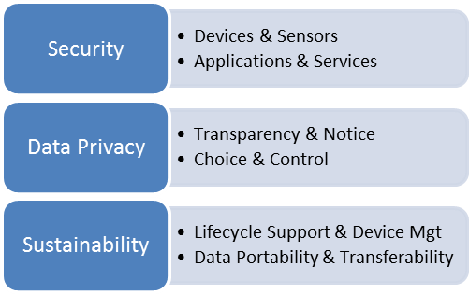
IoT Trust Framework
Multi-stakeholder working group
18 month, consensus driven process

Slide 14
IoT Trust Framework
Multi-stakeholder working group
18 month, consensus driven process

Slide 15
IoT Trust Framework
Multi-stakeholder working group
18 month, consensus driven process

Slide 16
Evolution
August 2015 – 93 criteria / principles identified
March 2016 – v1 released at RSA (30 principles)
January 2017 – v2.0 released at CES (37 principles)
June 2017 – v2.5 released (40 principles)
Latest version posted at https://otalliance.org/IoT

Slide 17
Framework Overview
The Framework is broken down into 40 evaluation criteria in 4 key areas:
Security Principles (1-12) – Secure software development process; security for data stored and transmitted by the device; securing production and the supply chain; requirement for secure life-cycle management.
User Access & Credentials (13-17) – Requirement of encryption of all passwords and user names, shipment of devices with unique passwords, implementation of generally accepted password reset processes and integration of mechanisms to help prevent “brute force” login attempts.
Privacy, Disclosures & Transparency (18-33) – Clear information for the user, ability to reset devices to factory settings, and compliance with applicable regulatory requirements including the EU GDPR and children’s privacy regulations. Impact on functionality if connectivity is disabled.
Notifications & Related Best Practices (34-40) – Secure, reliable user notification of issues; tamper-proof packaging and accessibility requirements.

Slide 18
Our work on consumer IoT, in partnership with Consumers International
5

Slide 19
The Internet Society Calls for Responsible Data Handling
For users:
Clear guidance at the point of decision
Transparency of data usage
Effective accountability and redress
For data controllers:
Practical guidance about ethical design
A clear trust framework for certification
Cross-border audit and accountability
Ethical data handling creates a virtuous cycle
Data controllers go beyond compliance
Economic growth is more sustainable
Users can make better choices
Ethical data handling builds trust
User trust encourages innovation
Notes:
Goals: to encourage ethical data handling by data controllers, offering consumers better choices that lead to trustworthy business models and sustainable economic growth.
Give data controllers a framework and practical guidance on ethical data principles and practices;
Make it easy for users to make a trust decision at the point of choice;
Back this up with an assurance/accreditation scheme that reinforces trust in service providers;
Demonstrate the competitive advantage of user trust: innovation is adopted more readily and sustainably;
See “Data Ethics, The New Competitive Advantage” – Gry Hasselbalch and Pernille Tranberg, published with ISOC support.
A parallel is the use of Fairtrade logos in retail products.
Consumers see a recognisable trust mark, backed up by an auditable accreditation scheme that commits producers and retailers to specific principles.
It’s clear to retailers and producers what they need to do to qualify for the trust mark.
Independent third parties can assess and accredit retailers and producers.
Not everything in the supermarket is Fairtrade, but the existence of Fairtrade products demonstrates their economic viability, and raises the bar for other producers.
Over the long term, this influences what consumers expect and demand.
We believe a similar approach can be adapted to the ethical handling of consumers’ personal data, and that it will result in a more sustainable personal data economy.

Slide 20
Making Responsible Data Handling The New Norm
Consumers/citizens:
Consider the values that your choices reflect
Cultivate those habits that protect your interests
If necessary, “vote with your feet” (or your wallets)
Press for – and use - appropriate tools
In a data-driven economy, we are all stakeholders – point solutions do not fix systemic problems.
Data controllers:
Publish ethical data commitments and stand by them
Be honest and fair about consent and re-use
Be transparent about your business model
Embody ethics in product/service design
Policy makers:
Pre-empt or correct market failures
Prioritise sustainability in the data-driven economy
Policy, education, economics, regulation
Feed the cost of bad behaviour back to its origin
Notes:
Two practical examples to consider:
1 – Better technical options for consent and control (such as Kantara Initiative’s work on Consent Receipts)
2 – An ethical trustmark for service providers, showing they have been accredited and conform to a published set of ethical principles
You may get asked ”isn’t this already being done?” aren’t there already trust marks?
There are some, but they are usually national schemes (such as Truste, in the US, or tScheme in the UK),
whereas we are interested in creating a framework that can be global, with the flexibility to recognise that data
travels across cultural and jurisdictional boundaries. Existing schemes are also typically aimed specifically at
privacy (Truste) or identity assurance (tScheme), not at the more fundamental ethical principles, and how to
put them into practice.
We think that a greater focus on the fundamentals actually makes it easier for an organisation to achieve compliance
in the other areas, too.

Slide 21
Trust framework
✅
Clear, simple user guidance
At the decision point.
Trust Mark

Slide 22
Trust framework
✅
Clear, simple user guidance
at the decision point.
Trust Mark
Supplementary information
the user can find easily
Clear Principles

Slide 23
Trust framework
✅
Trust Mark
Expert group on
value-based design,
development and audit;
Repository of guidance.
Clear Principles
Assurance framework
(Guidance
and Deployment)
Assessment
Accreditation
Audit
Accountability
Policies
Processes

Slide 24
A reusable model
✅
Imagine the same approach applied to:
Labelling of apps
Procurement/supply chain management
Labelling of IoT devices for retail…
Trust Mark
Clear Principles
Assessment
Accreditation
Audit
Accountability
Policies
Processes

Slide 25
Robin Wilton
Technical Outreach Director, Trust and Identity
wilton@isoc.org
@futureidentity

