Slide 2
@CultivateCoders CultivatingCoders

Slide 3
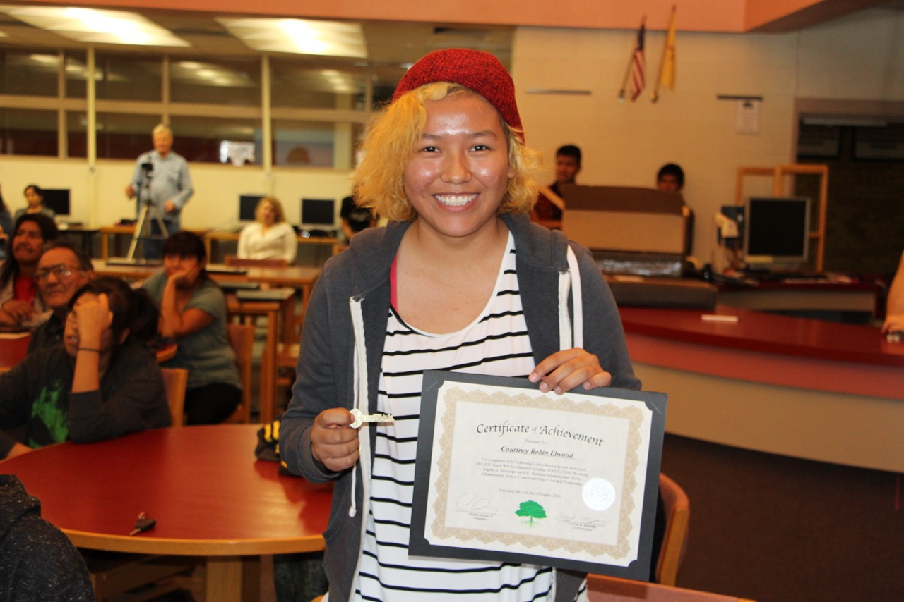

Slide 4
"When you can teach people to commit to things without knowing the answer, then they have a chance to compete in this world.” ~ Herm Edwards

