Slide 1
CyberSecurity Trends and Threats
Brandon Benallie
http://www.Benallie.com
Brandon@Benallie.com
505.552.3533

Slide 2
Threat Landscape
Malicious Intent
Social Engineering
Malicious Content (i.e. Ransomware)
Information Leakage
Access Abuse

Slide 3
Threat Landscape - Internal Threats
In 2016, internal threats were responsible for 80% of all data breaches

Slide 4
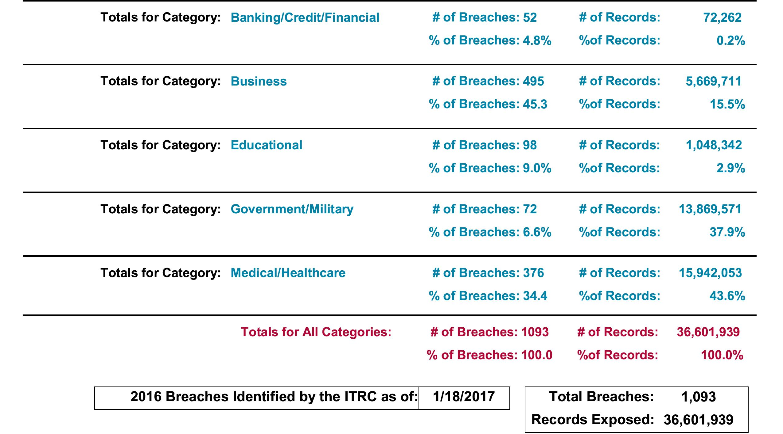

Slide 5
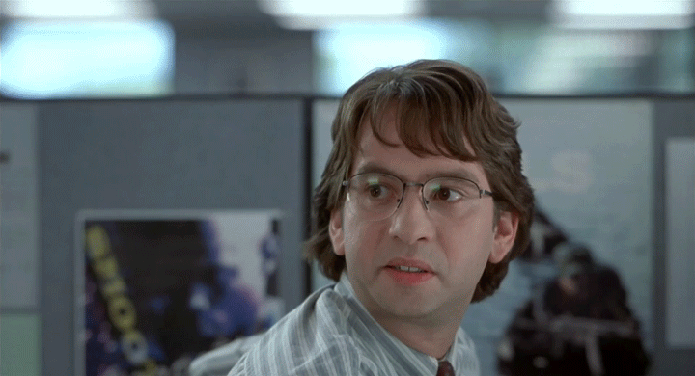
Threat Landscape - Internal Threats
Malicious Intent
Disgruntled employees with privileged access
ePHI and PII
Financial Data
Technical Data

Slide 6
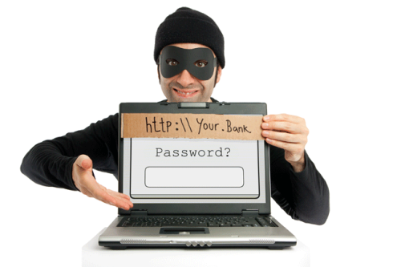
Threat Landscape - Internal Threats
Social Engineering
Exploits trust of employees
Not fixed with technical solutions
Only user education can “fix”
You are naturally trusting, helpful
You don’t want to look stupid, get in trouble
You are impatient

Slide 7
Threat Landscape - Internal Threats
In May and June of 2017, for the first time ever, Data Breaches caused by Users were surpassed by …

Slide 8
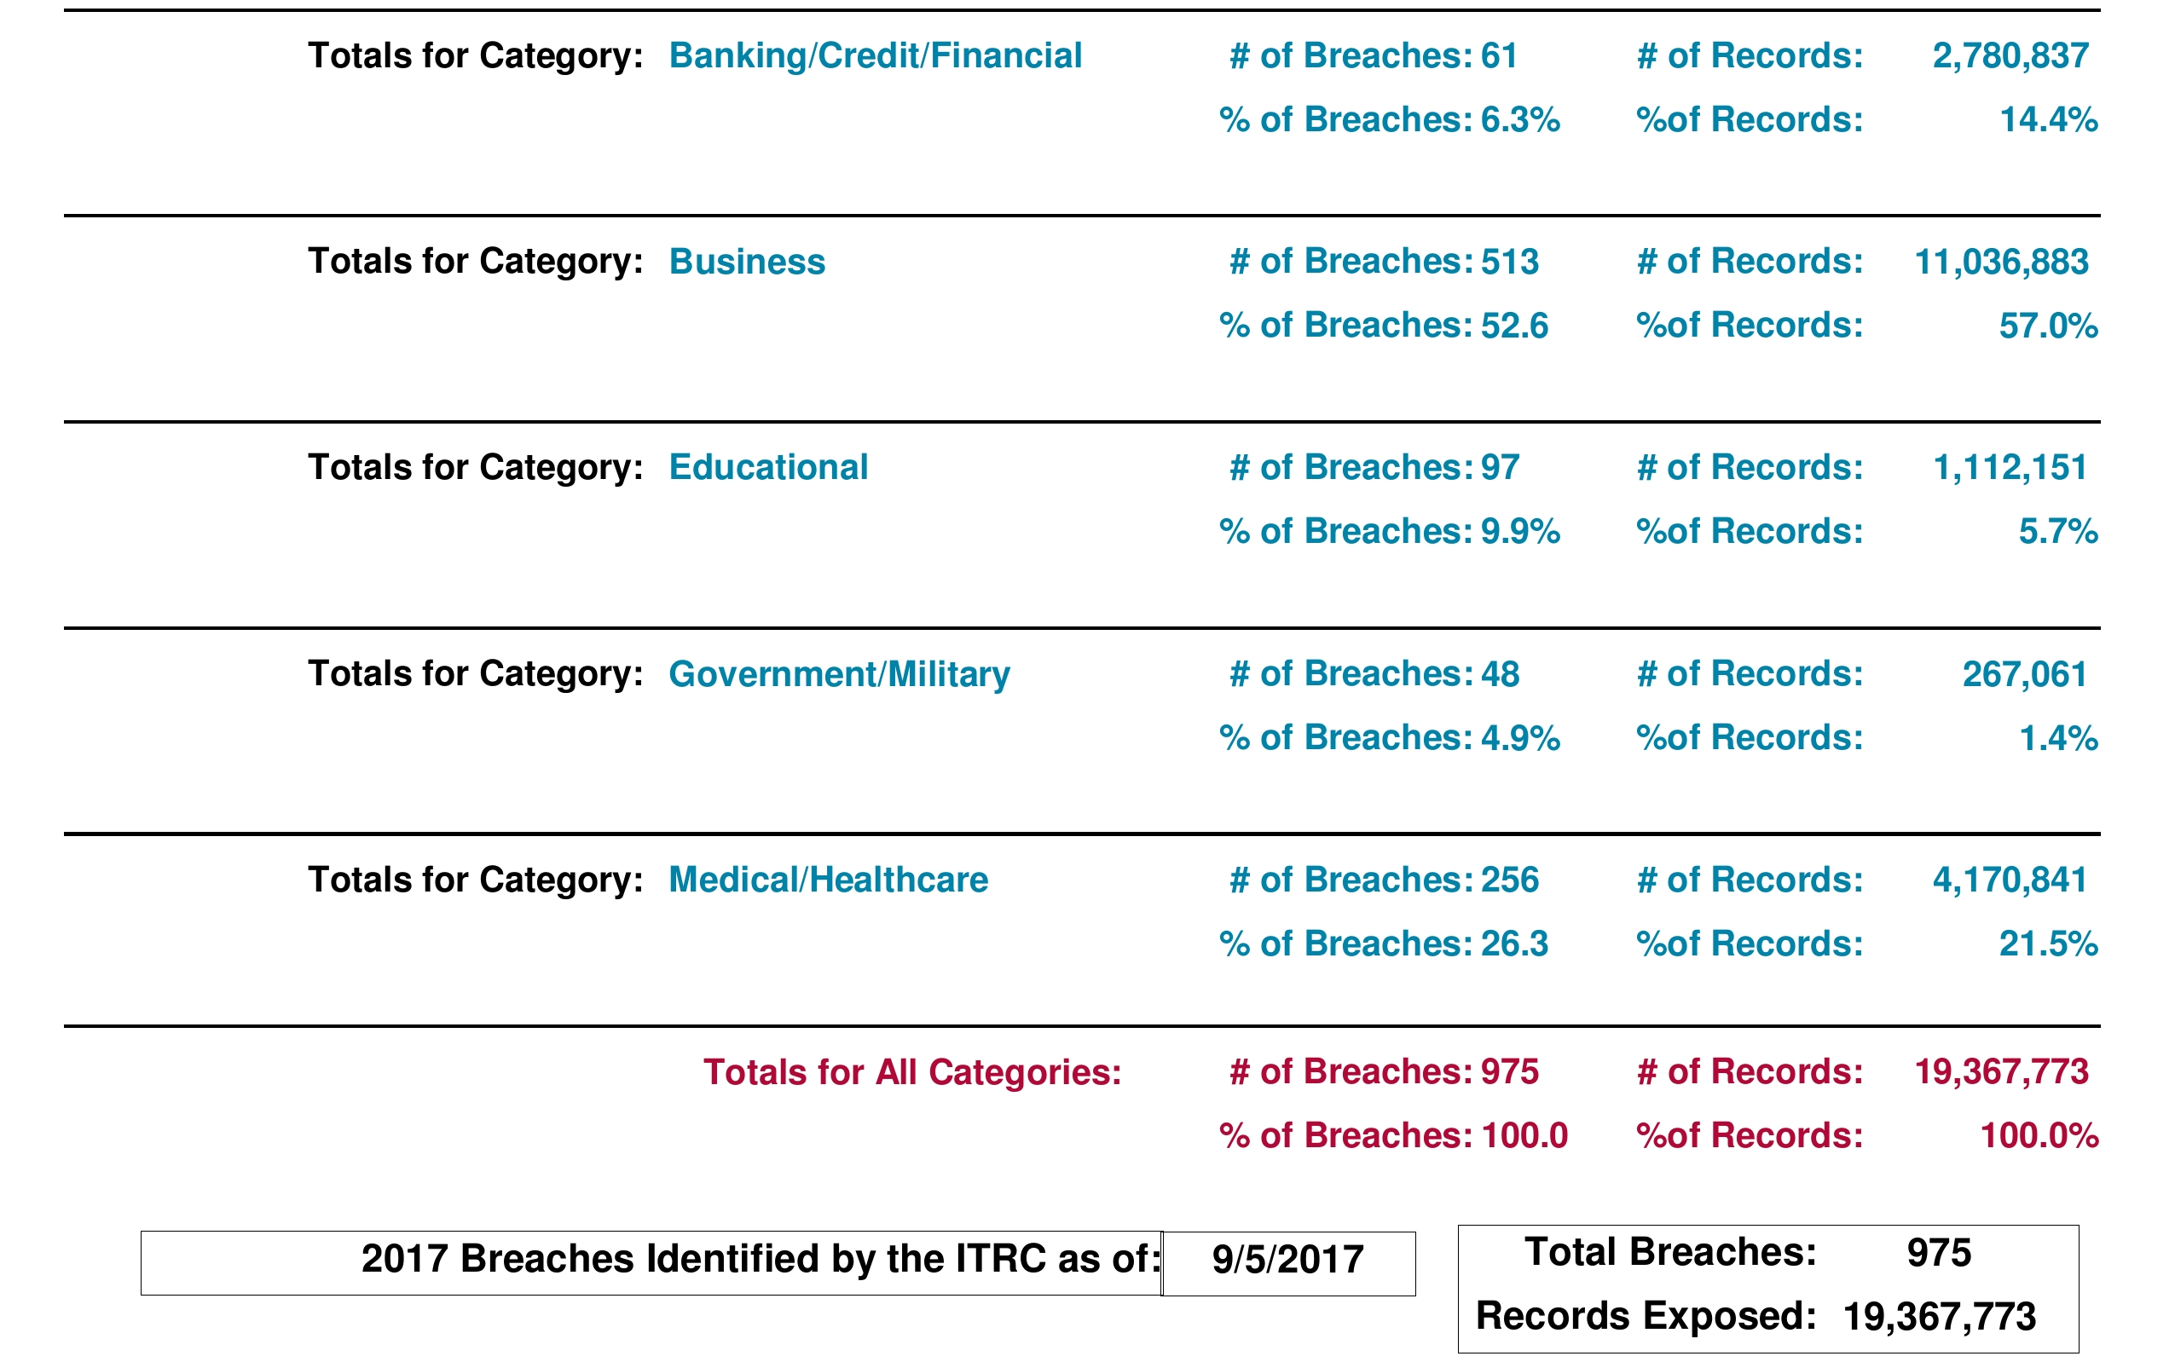

Slide 9
Threat Landscape – Internal Threats

Slide 10
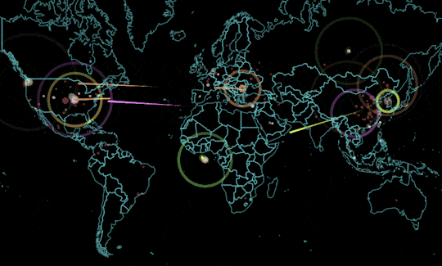
Threat Landscape - Internal Threats
Within 48 hours, “WannaCry” ransomware infected over 100,00 organizations globally before being stopped.

Slide 11
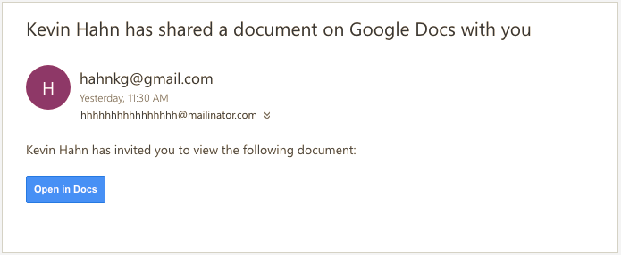
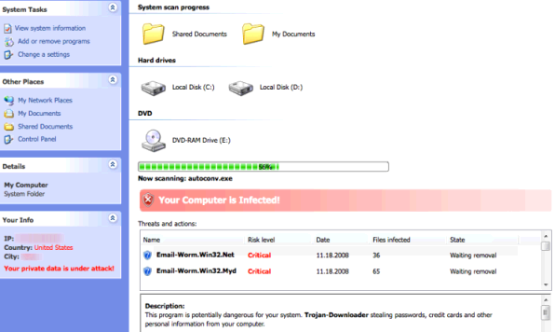
Threat Landscape - Internal Threats
Malicious Content.
Ransomware encrypts Data/Files and demands money to decrypt
Once encrypted, no way to view files again unless you have decryption “key”
Infection via compromised E-mail accounts, Websites, and unpatched or unsupported Microsoft Windows Systems

Slide 12
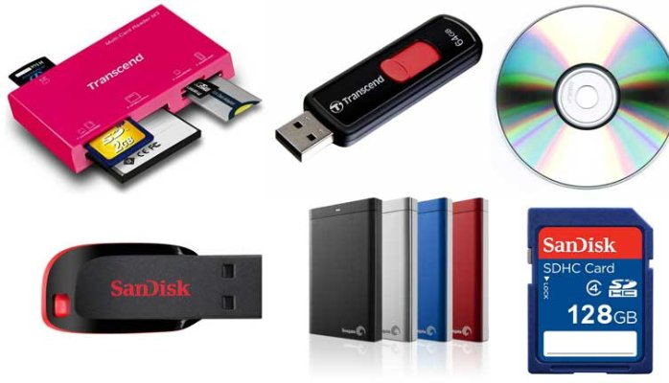
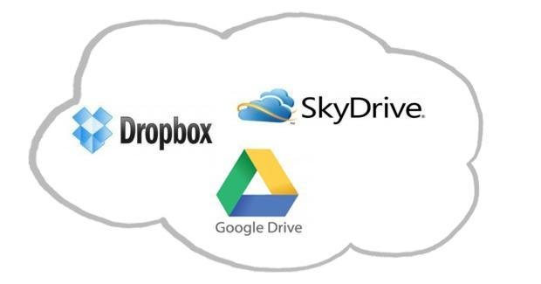
Threat Landscape - Internal Threats
Information Leakage
BYOD or PED (Bring Your Own Device, Personal Electronic Device)
Easily walk away with Gigabytes of Data
“Cloud Storage”
Personal Webmail

Slide 13
Threat Landscape - Internal Threats
Illegal Activities
Abusing network access and resources
Visiting sites they shouldn't be visiting
An aspiring script kiddie

Slide 14
Cyber Threats Cannot Be Eliminated, Only Mitigated

Slide 15
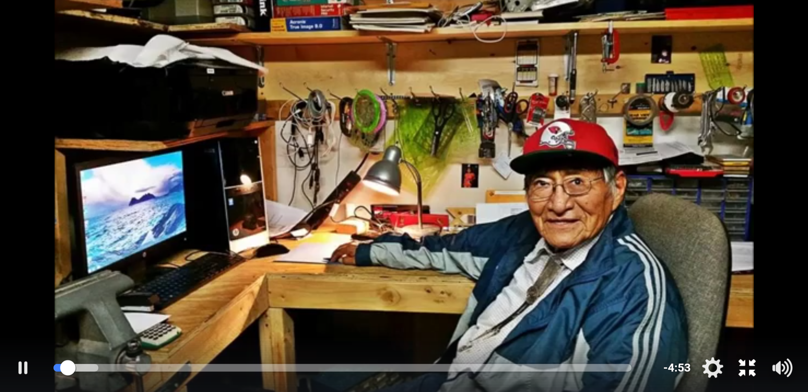
Preparing ourselves for External Threats
Do grandma and grandpa know what social engineering, phishing, and malware are?

Slide 16
Preparing ourselves for External Threats
User training and awareness
Tabletop exercises
Disaster recovery plan
Hot sites (backup datacenter / network)
Create a modular secure network architecture

Slide 17
AXHÉ’HÉÉ/THANK YOU
Brandon Benallie
http://www.Benallie.com
Brandon@Benallie.com
505.552.2533

