Slide 1
Promoting African Internet Economy
Dawit Bekele
Director, African Regional Bureau
Internet Society

Slide 2
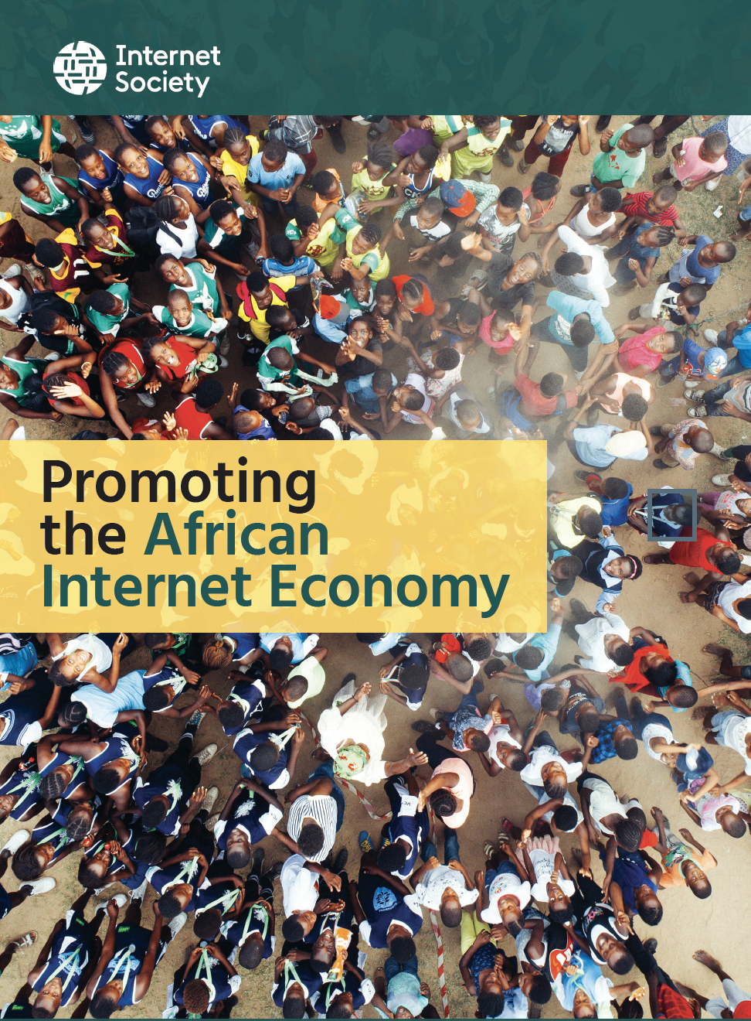

Slide 3
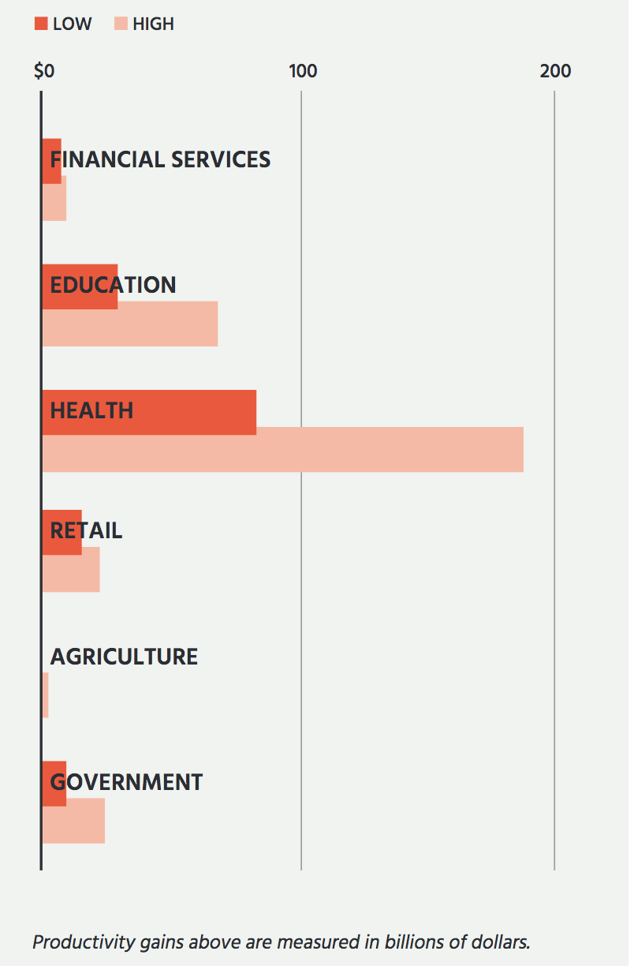
Introduction
1/3rd of Africans have access to the Internet
Contribution of Internet to the GDP: 1.1 %
Internet has greater impact on economic growth for developing countries
10% increase of Internet penetration 0.4% to 0.6% of GDP growth
Use the Internet to financial services, education, health, retail, agriculture and government shows that those sectors can make a saving from 10% to 75%
Source: McKinsey Global Institute

Slide 4
Successes
Close to 80% of worldwide Mobile Money users are in Africa
Innovation hubs are being built all over Africa with varying successes
Some successful applications
Jumia, online supermarket in Nigeria, Kenya, etc.
Benben: blockchain based land management system in Ghana
Twiga Foods and Icow in Kenya, FarmFresh in Gambia

Slide 5
Challenges
Ecommerce businesses for Middle/East and Africa is just 1%
But Middle/Easters and Africans are about 7% of the world online consumers
2 in 5 businesses don’t use Email
1 in 3 businesses don’t have website

Slide 6
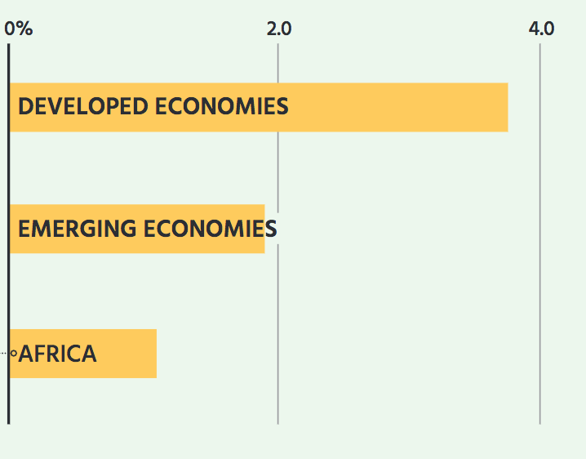
Challenges
Development of Internet in the continent is very uneven
Contribution to the Economy low
Africa: 1.1%
Emerging economies: 1.9%
Developed countries: 3.6%
Ecommerce for Middle/East and Africa: 1%
Online consumers Middle/Eastern and Africans: 7%
2 in 5 businesses don’t use Email
1 in 3 businesses don’t have websites

Slide 7
Roadblocks
Issues that impact ability to start new businesses
Startups
Conditions for online business offerings, regardless of sector, including developing Internet platforms
Online Business
General ease of doing business, online or offline
Business Environment

Slide 8
Conclusion
Nascent African Internet Economy
Many opportunities but also many challenges
Some countries will immerge
Some will loose the opportunity

Slide 9
Dawit Bekele
African Regional Bureau
bekele@isoc.org

Slide 10
There are many ways to support the Internet. Find out today how you can make an impact.

